Slide 1

JUCE

Slide 2


JUCE - Jules' Utility Class Extensions
Created in 2004 by Jules Storer
open source cross-platform C++ codebase for developing desktop and mobile applications, & plug-ins
allows software to be written such that it runs with same user experience, on many platforms & in many formats
contains classes covering many other commonly used features
UI elements, graphics, audio, XML & JSON parsing, networking, cryptography, multi-threading…
reduces number of third-party libraries needed
Supports Windows, macOS, Linux, iOS and Android operating systems

Slide 3
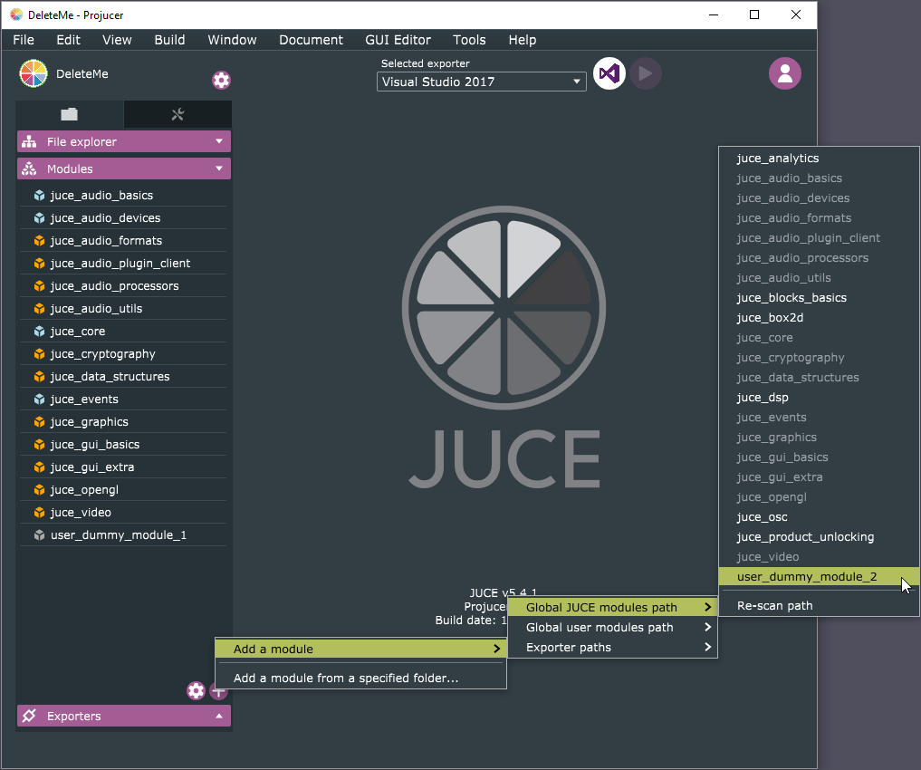
The Projucer
JUCE’s build configuration tool for creating and managing JUCE projects
Once files and settings for JUCE project specified, it automatically generates 3rd-party project files to allow project to compile natively on each target platform
Visual Studio, Xcode, Android Studio, CodeBlocks and Linux Makefiles
Also has code editor, integrated GUI editor, wizards for creating new projects and files

Slide 4
JUCE and audio
Most widely used framework for audio application and plug-in development
Large audio functionality
Support for audio devices (such as CoreAudio, JACK, DirectSound) and MIDI playback, DSP building blocks, polyphonic synthesizers…
built-in readers for common audio file formats (WAV, AIFF, FLAC, MP3, Vorbis…)
Comes with wrapper classes for building audio plugins
Single binary produced that supports multiple audio plugin formats
Supports VST, VST3, AU, AUv3, AAX, LV2 … plug-in formats
Use in DAWs like Logic, Live, Pro Tools, FL Studio or Cubase
Since all platform and format-specific code is contained in the wrapper, user can build for almost any plug-in format & platform from single codebase

Slide 5
Basic JUCE audio plug-in components and their relationship to the DAW
PluginEditor
PluginProcessor
GUI Handlers
Parameter Controls
GUI
sliderValueChanged()
...and other control types
timerCallback()
called periodically by system
setValue()
getValue()
Init. and Cleanup
DAW
prepareToPlay()
releaseResources()
called once before starting
called once after finishing
Audio Callback
called continuously while running
processBlock()

Slide 6
What we will do
We will use JUCE to develop VST plugins
We will learn how to process audio samples and MIDI in applications and plug-ins
We will prototype and deploy different audio effects, filters, instruments and generators
Learn C++, JUCE, VST, Midi
Learn audio processing and programming concepts

